Slide 1
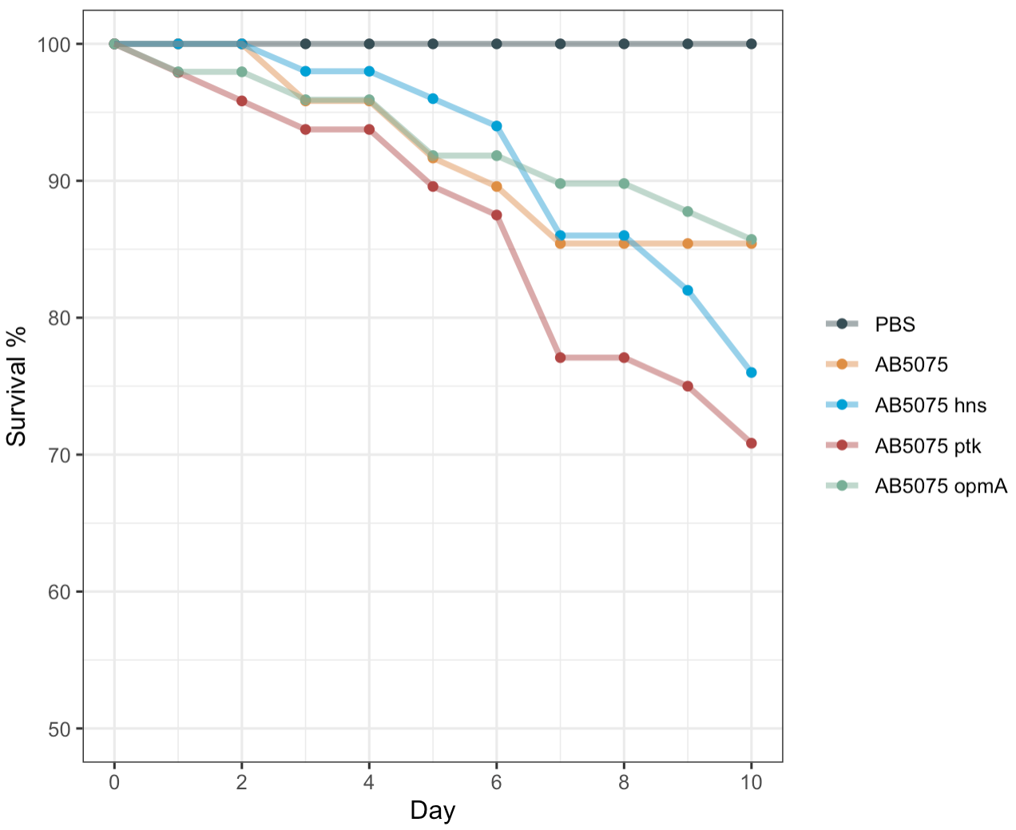
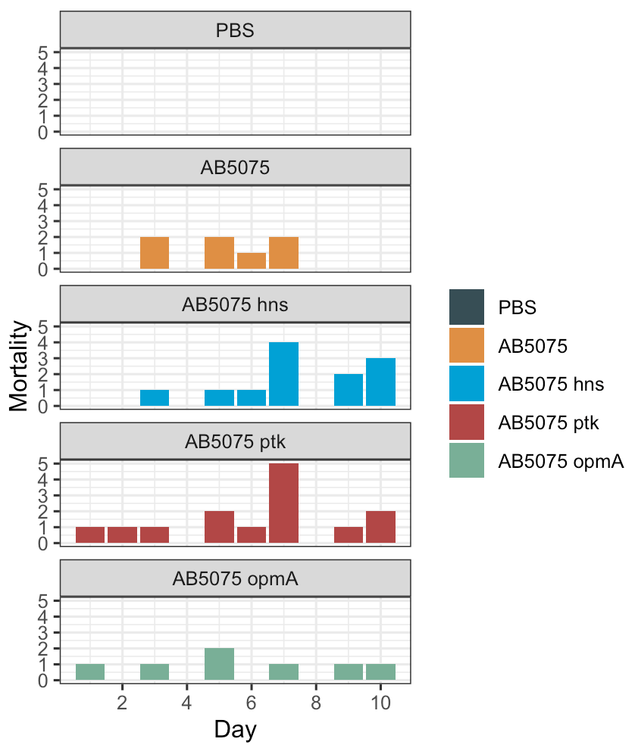
Survival Percent (raw data)
Death Count (raw data)
Last edited: 01/10/2020

Slide 2
Survival Percent (raw data)
Log-Rank Test
** Low p-values highlighted
Treatment I | Treatment II | P-value
PBS | AB5075 | 0.04590
 | AB5075 hns | 0.00245 **
 | AB5075 ptk | 0.00046 **
 | AB5075 opmA | 0.04590
Treatment I | Treatment II | P-value
AB5075 | AB5075 hns | 1.00000
 | AB5075 ptk | 0.49884
 | AB5075 opmA | 1.00000
Treatment I | Treatment II | P-value
AB5075 hns | AB5075 ptk | 1.00000
 | AB5075 opmA | 1.00000
Treatment I | Treatment II | P-value
AB5075 ptk | AB5075 opmA | 0.49489
Last edited: 01/10/2020

Slide 3
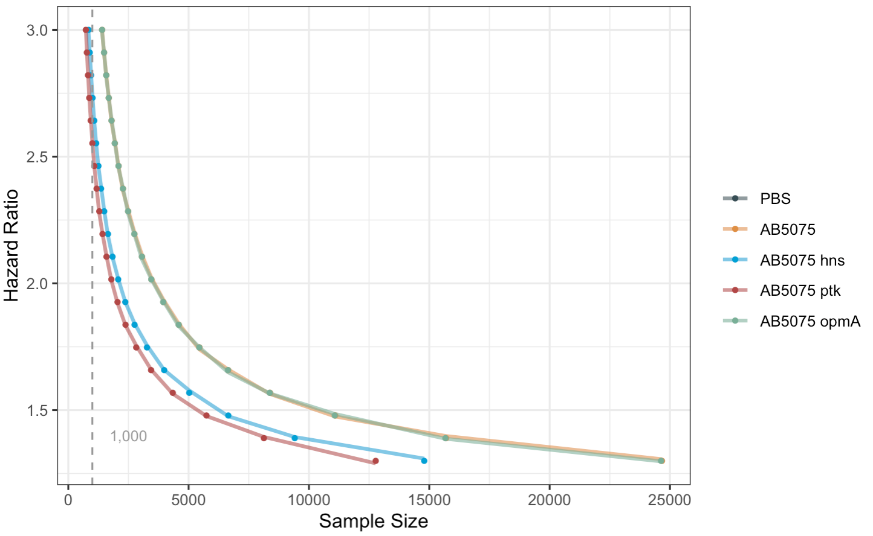
Power Analysis for Log-Rank Test
Type I error $α$ (two-tailed) = 0.05; Power $β$ = 90% (Type II error $β$=0.10
Last edited: 01/10/2020

